Slide 1
Building Web AppS With Vue.js
Raymond Camden

Slide 2

Who am i?
Raymond Camden
Developer Evangelist for HERE Technologies
Blogging at raymondcamden.com
Tweeting at raymondcamden

Slide 3
Gameplan
Go over "requirements"
Talk about Vue at a high level (somewhat quick!)
Vue Syntax (basic stuff, but a lot of em!)
Components
Working with the CLI and Applications
Routing
Vuex (State management)
Vue 3.0 – What to Expect
Wrap Up
Notes:
requirements is in quotes as its going to be pretty loose

Slide 4
Requirements
Assets (most code, slide deck, etc) - https://github.com/cfjedimaster/vue-workshop
Exercises:
An editor (any editor is fine but Visual Studio Code is best)
Or Codepen (codepen.io) or Code Sandbox (codesandbox.io)
A web server (npm i -g httpster)
Web browser

Slide 5

Why Vue?
Notes:
btw, im going to say vue and not vuejs just to keep things

Slide 6
Let’s back up…
Notes:
Do we need a framework?
Yes.
Helps decide where shit goes.
Helps manage complexity

Slide 7


SIMPLE
Notes:
Approachable

Slide 8
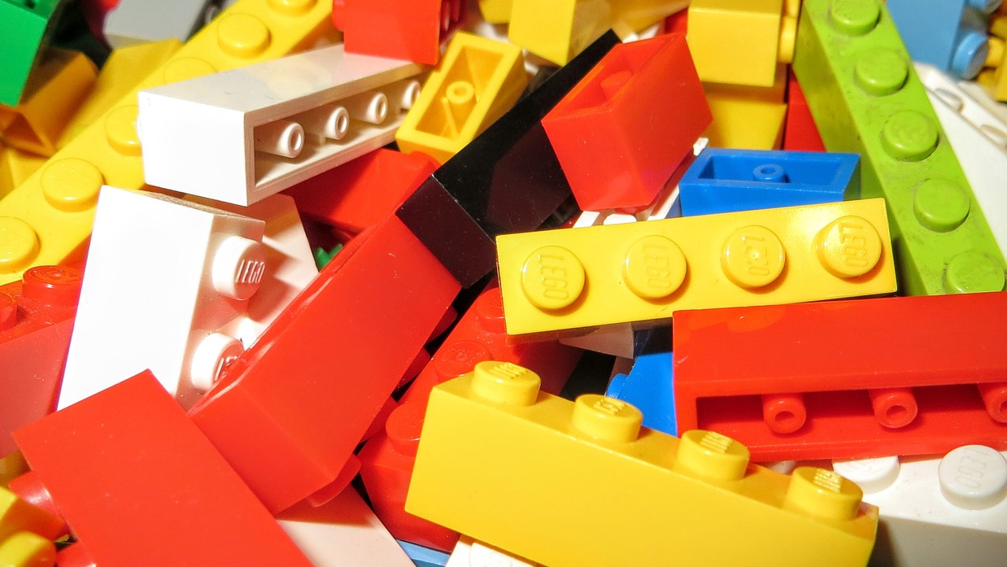
No Build Process
Notes:
Easy to add to existing sites

Slide 9

Scalable

Slide 10

Quick Vue Facts
Created by Evan You (@youyuxi)
Released in February of 2014
"Currently" is version 2.6.11
Main site: vuejs.org
GitHub: https://github.com/vuejs

Slide 11
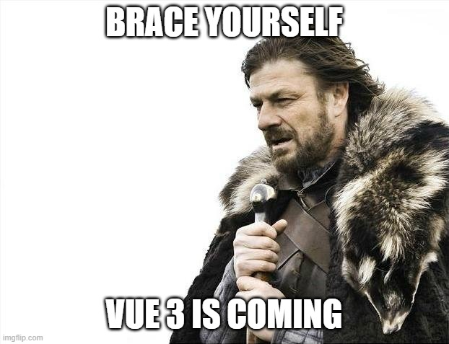

Slide 12
What does vue do?
Two-way binding between your DOM and JavaScript
Template Language (aka Declarative Rendering)
And I know I said this - but it does more. A lot more.
Notes:
Let me stress - VUE DOES MORE THEN THIS! When I start learning something I will intentionally ignore things that I think I'm not quite ready for yet, so when I first started, Vue did two things for me.
Two-way binding - not terribly exciting but really useful. So if I want to put a form field on a page and know when it changes, or I want to set it based on some condition or an Ajax load, Vue makes that easy.
By template language (and the docs call it Declarative Rendering), I basically have a way of saying that if I have a JS variable called name and the value is ray, I want to show that on the page. That's not terribly exciting, but it goes very deep. Instead of a simple variable name I could have an array of names. Vue has a way to render that. WHat if name was empty of not yet defined? Vue provides conditionals. So if you've ever used or heard of Jade (now called Pug), Handlebars, Mustache, etc, than Vue has this baked in.

Slide 13

Installation
npm install
cli install
Download from site
Copy and paste a script tag FTW!!!!!1!

Slide 14
<script> Style
<!-- dev -->
<script src="https://cdn.jsdelivr.net/npm/vue/dist/vue.js"></script>
<!-- prod -->
<script src="https://cdn.jsdelivr.net/npm/vue@2.6.11"></script>

Slide 15
Write SOme Code!
Identify where you're going to render stuff
Setup some data
Render that data
Add events (ie on this do that) and other fancy stuff

Slide 16




Willy Nilly DOM Manipulation
$('#somediv').html('woot');
$('#someotherdiv').val(2);
$('#yetanotherdiv').html('<b>This is awesome</b>');

Slide 17
Defining Vue's Place...

Slide 18

Examples
http://bit.ly/rayvuedemos
Notes:
Show the link in Edge, show picking one and editing

Slide 19
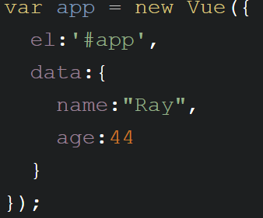
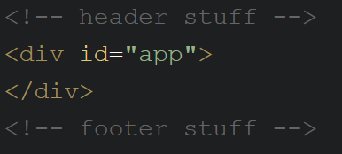
Some code...

Slide 20
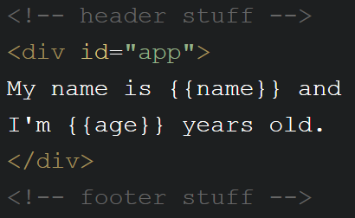
Some MORE code...

Slide 21
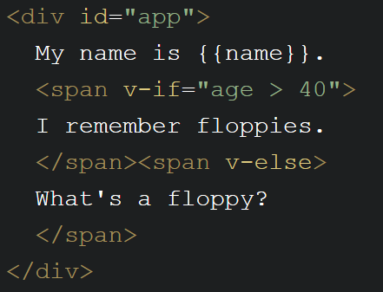
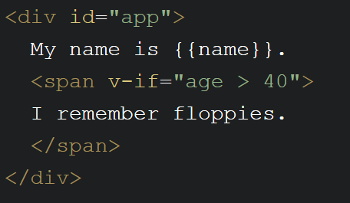
Template Directives - Conditionals
Notes:
code pen

Slide 22
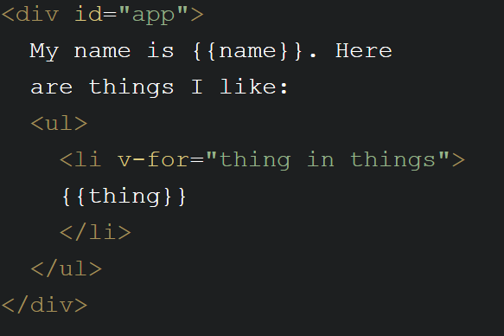
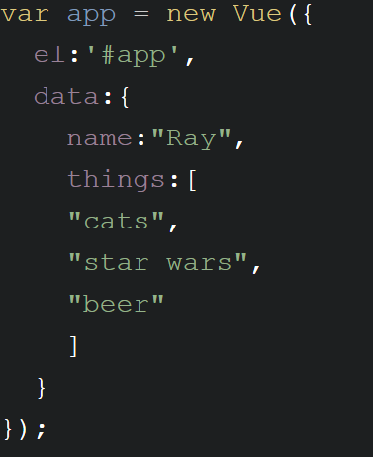
Template Directives - Loops
Notes:
code pen

Slide 23
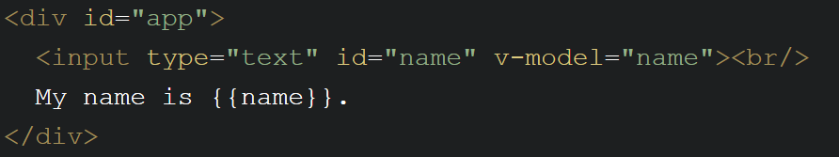
Working with Form Fields
v-model links to data field
Works in all kinds of form fields
Bigger demo: https://www.raymondcamden.com/2020/01/27/vue-and-form-fields

Slide 24
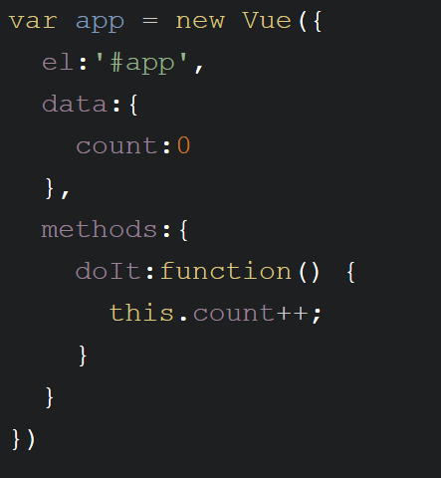
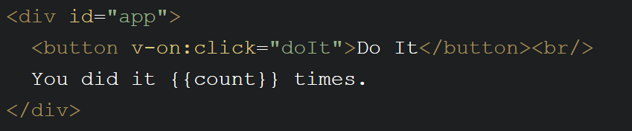
Events
v-on:click=“something”
Defined in methods block of Vue instance
Easy to do modifiers (v-on:submit.prevent)
@click=“something”

Slide 25
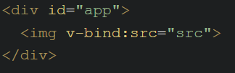
Attribute BInding
v-bind:attribute=“value”
:attribute=“value”
v-bind:style="{bgcolor:curColor, font-style:textStyle}"
v-bind:class="{highlighted:isActive, color:appStatus}"

Slide 26
Computed Properties
Virtual properties
Property X is based on real data A and B
Defined in the computed part of the Vue instance

Slide 27
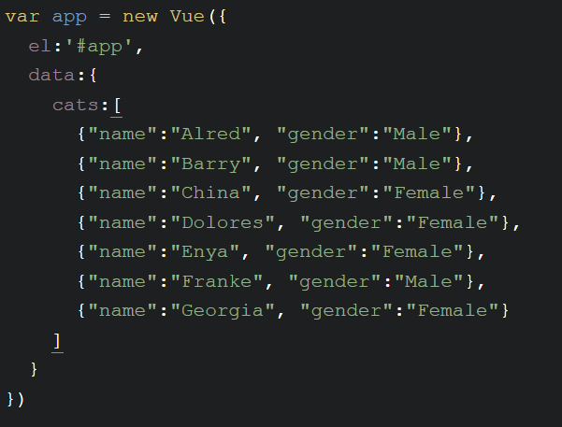
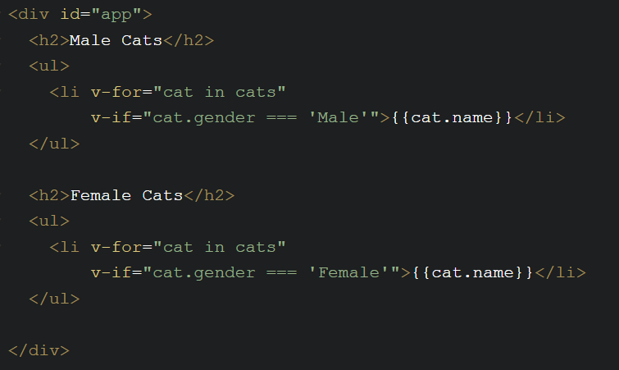
Example (Before)

Slide 28
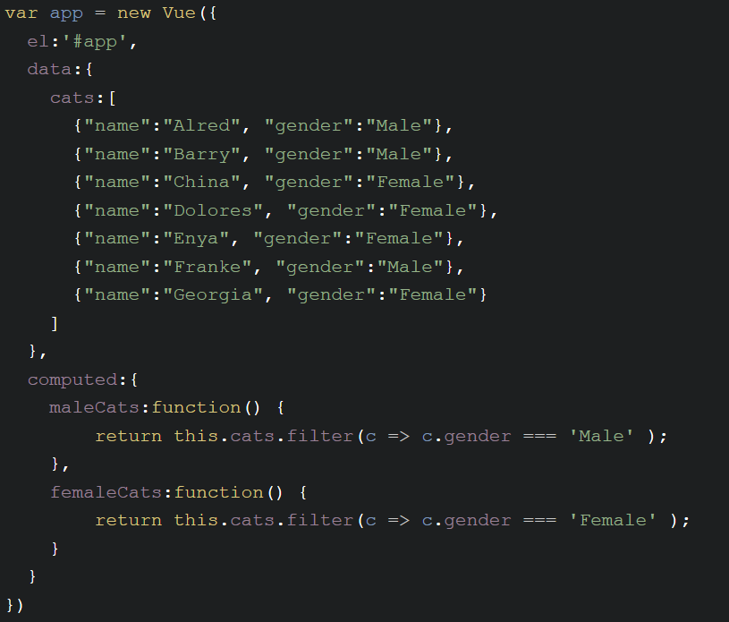
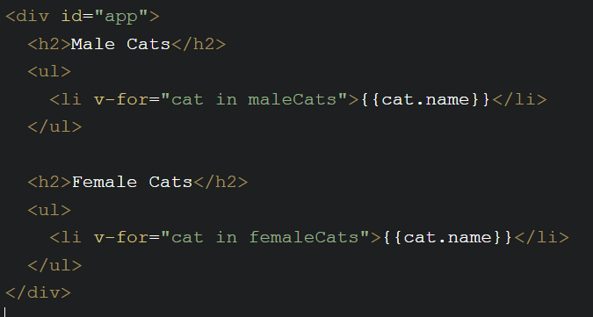
Example (After)
Notes:
demo app.cats.push

Slide 29
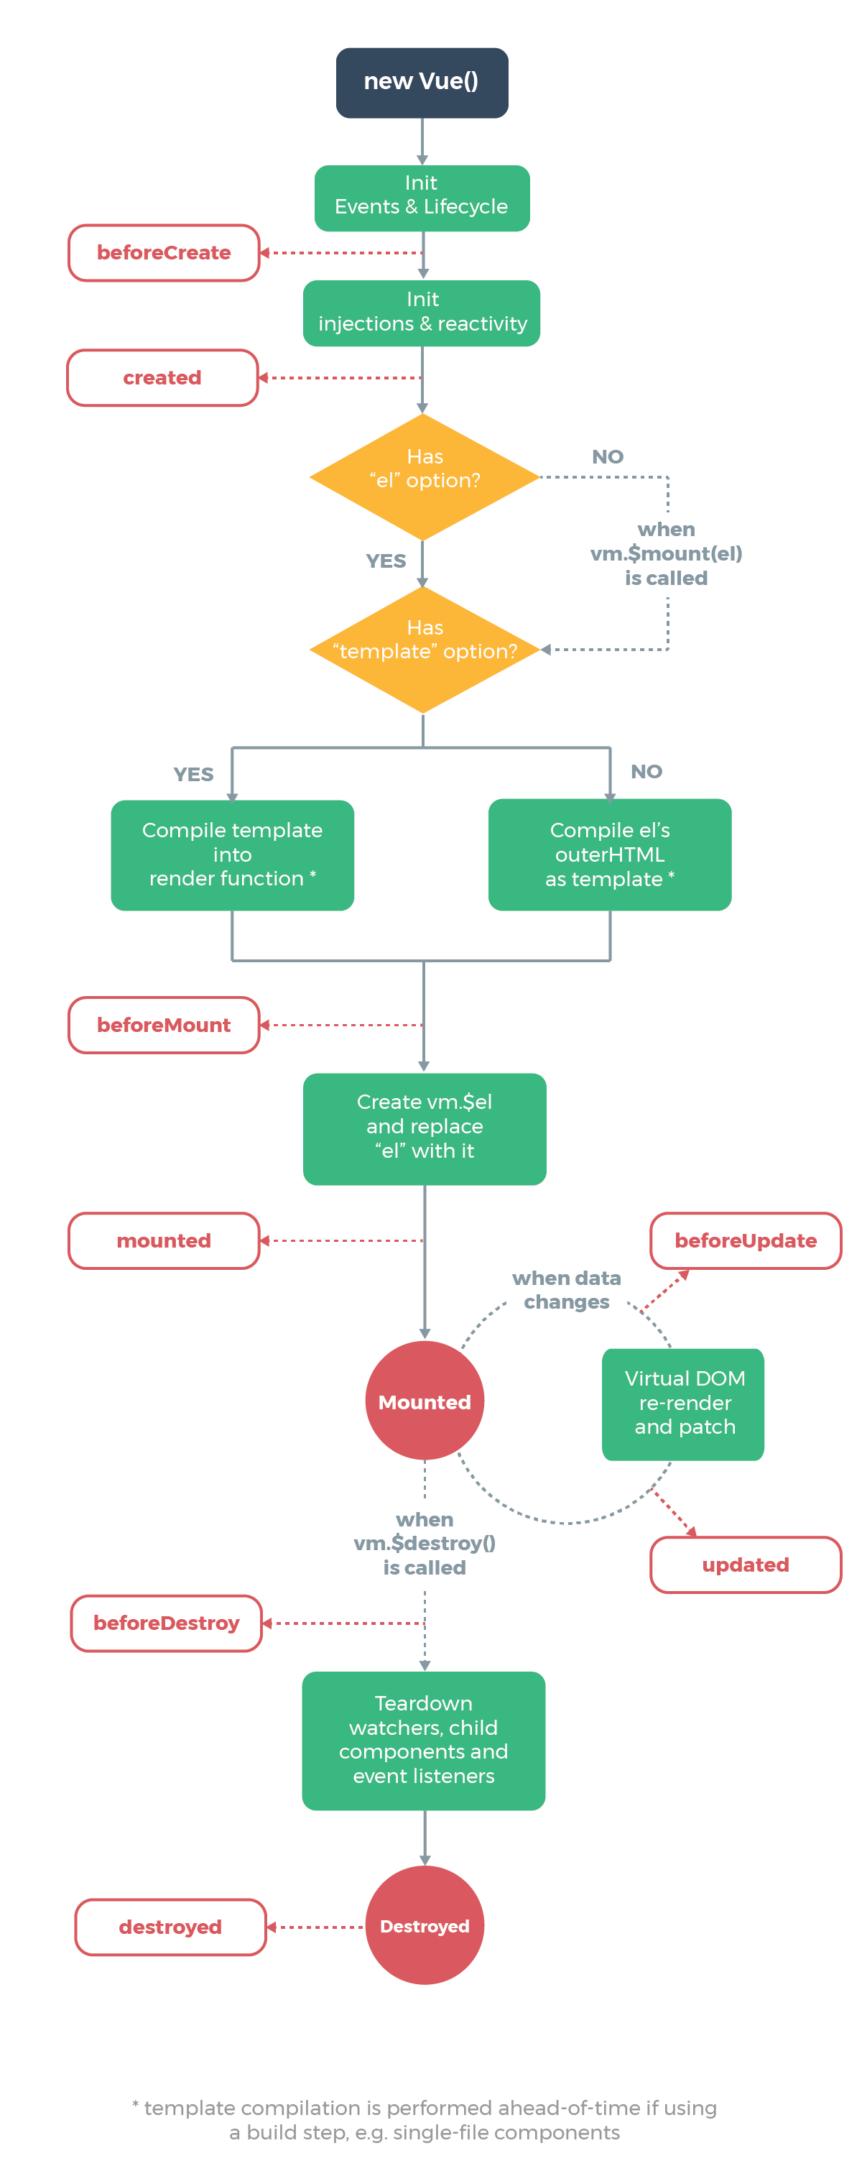
Vue Lifecycle Events
Events that occur while a Vue instance is doing stuff
beforeCreate, created, beforeMount, mounted, beforeUpate, updated, activated, deactivated, beforeDestroy, destroyed, errorCaptured
https://vuejs.org/v2/api/#Options-Lifecycle-Hooks

Slide 30
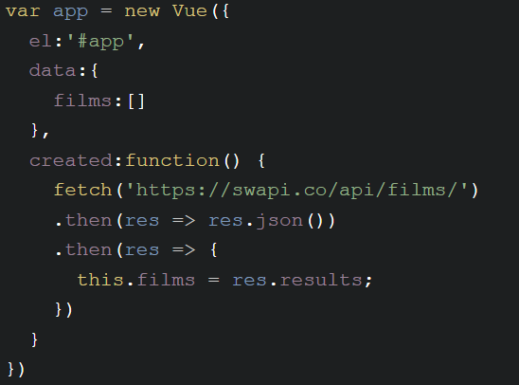
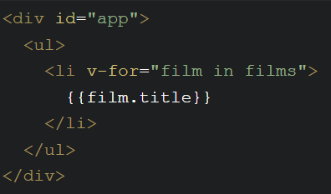
Example

Slide 31
Filters
Allow you to define a "formatter" for a value
{{ birthDate | formatDate }}
v-bind:something="someValue | changeValue"
Chainable: {{ birthdate | makeMeNotOld | formatDate }}
Arguments: {{ birthdate | formateDate('short') }}

Slide 32
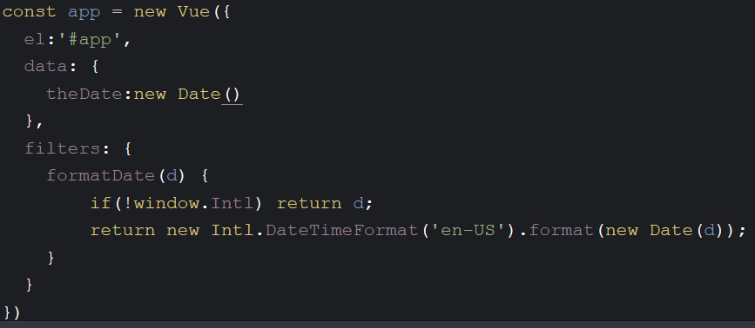
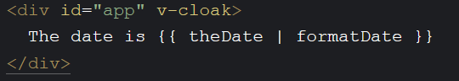
Example

Slide 33
Quick Tip
Hiding the FOUC (Flash of Unstyled Content
Add v-cloak to DOM item "holding" your app
Add a style declaration to hide it.

Slide 34
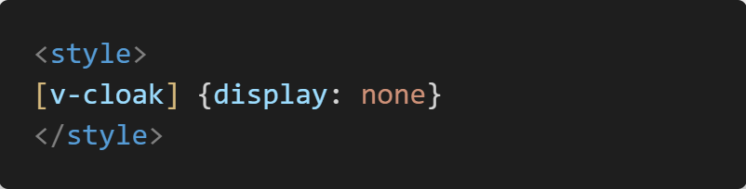
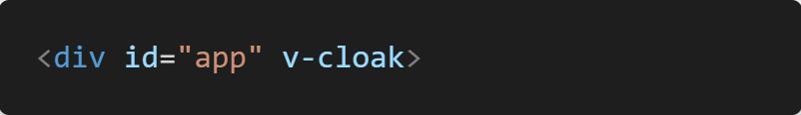

Slide 35
Full Example: Form Validation
Do I need to explain this?
Check on submit, report on top
More examples: https://vuejs.org/v2/cookbook/form-validation.html

Slide 36
Full Example: Ajax Search
Accept user input
Send to remote API...
https://www.openbrewerydb.org/documentation/03-search
Render responses

Slide 37

Break

Slide 38
Components
Re-usable objects of awesome-ness
Template + Logic + Style = Component
Also solves one of HTML's most glaring problems...

Slide 39

<nicolas-cage>

Slide 40
Component Parts
Register the name
Contain “regular” Vue properties: data, computed, methods
Contains a template (the HTML rendered)
Possibly contains props (defining name, required, type, etc)
Can be registered globally or just to one Vue app/component

Slide 41
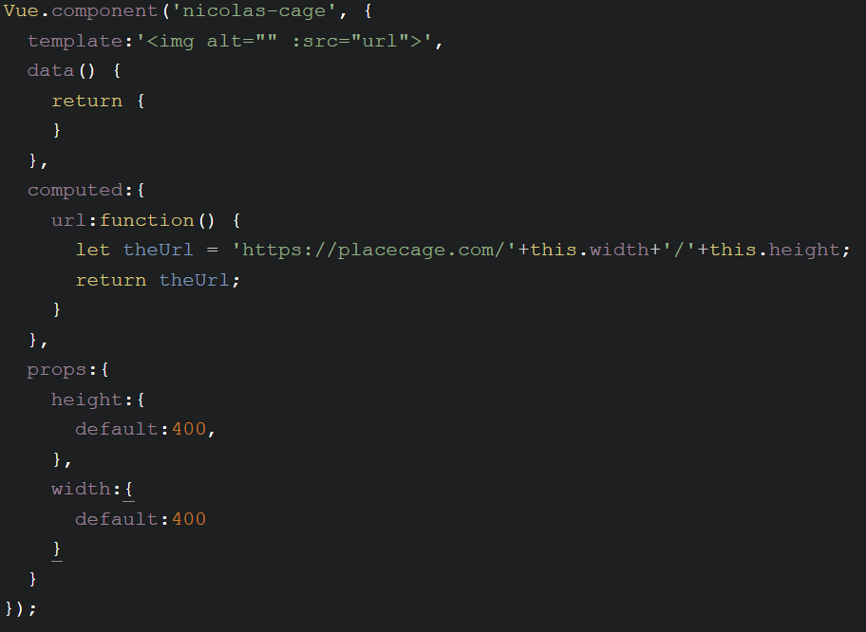
Example

Slide 42
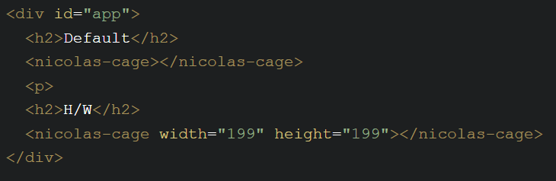
Example

Slide 43
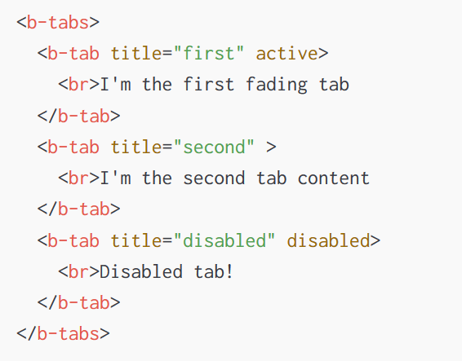
Component Examples
Google Static Maps: https://www.npmjs.com/package/vue-static-map
Bootstrap: https://bootstrap-vue.js.org/
Vuetify: https://vuetifyjs.com/en/

Slide 44
More Component Stuff
Data must be a function
You can pass data in from the parent
You can listen for events from the component ($emit)

Slide 45
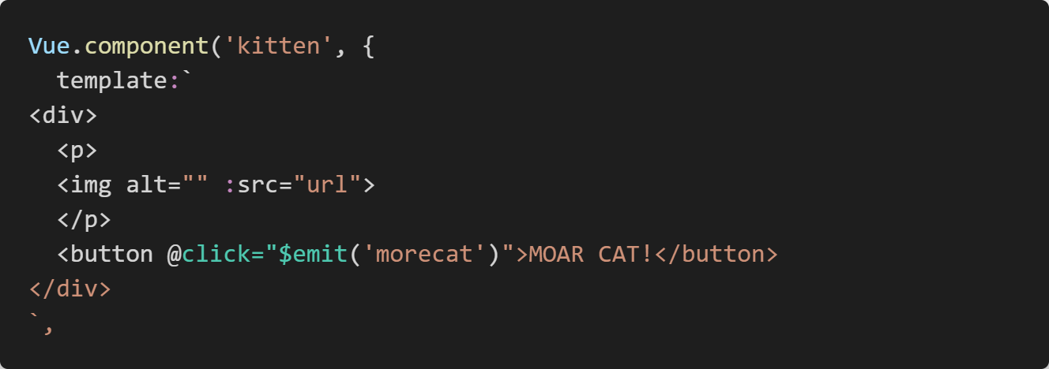
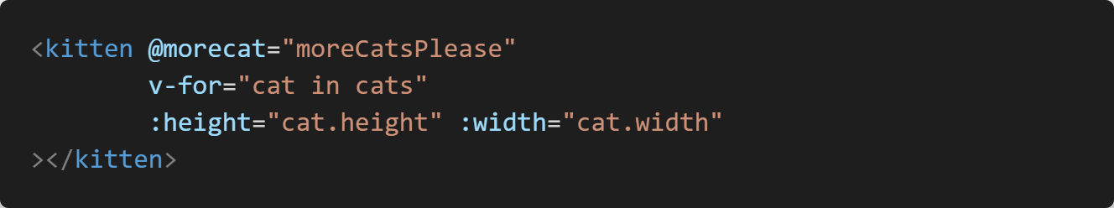
Example

Slide 46
More Component Stuff
Slots lets you pass information to components in a more free form manner.
In ways, the same as props, but you have more freedom.

Slide 47
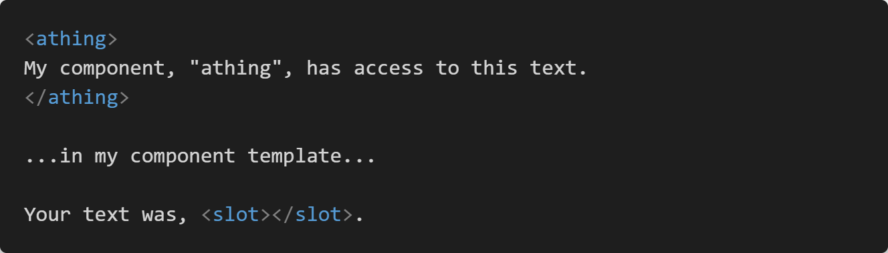

Slide 48
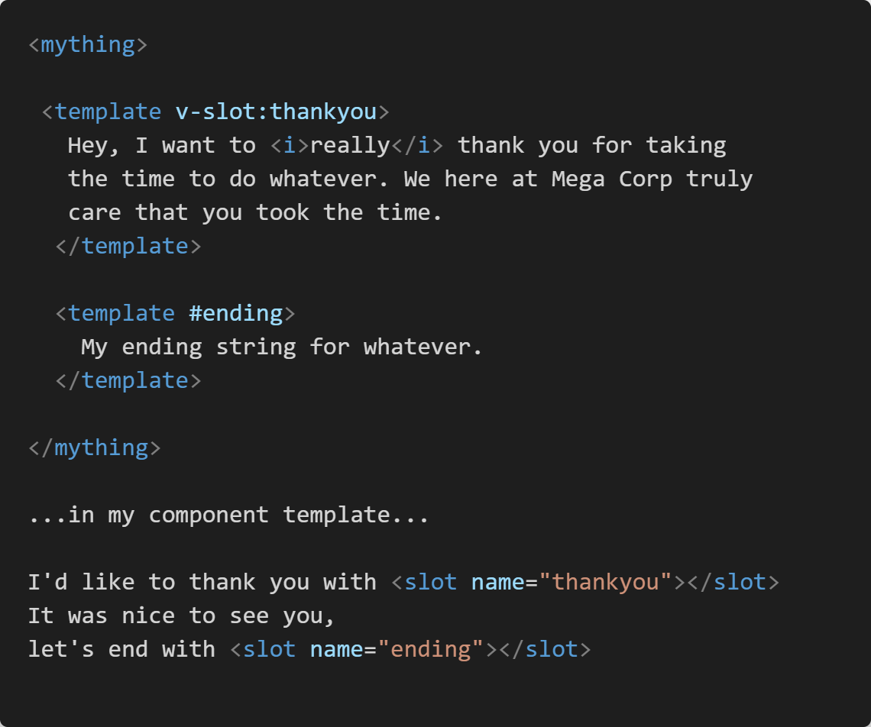

Slide 49
Full Example: Placeholder
Create an <image-placeholder> tag
Use placeholder.com (or any other service)
Accept height and width (with defaults)

Slide 50
Break

Slide 51
Page Enhancement versus Apps
Warning: Opinions Incoming...
What do we mean by "app"?
When do you use which?
Notes:
Discuss "page enhancement versus apps"
When which? login + content + detail

Slide 52

App Time!
Notes:
you've decided it's App time!

Slide 53
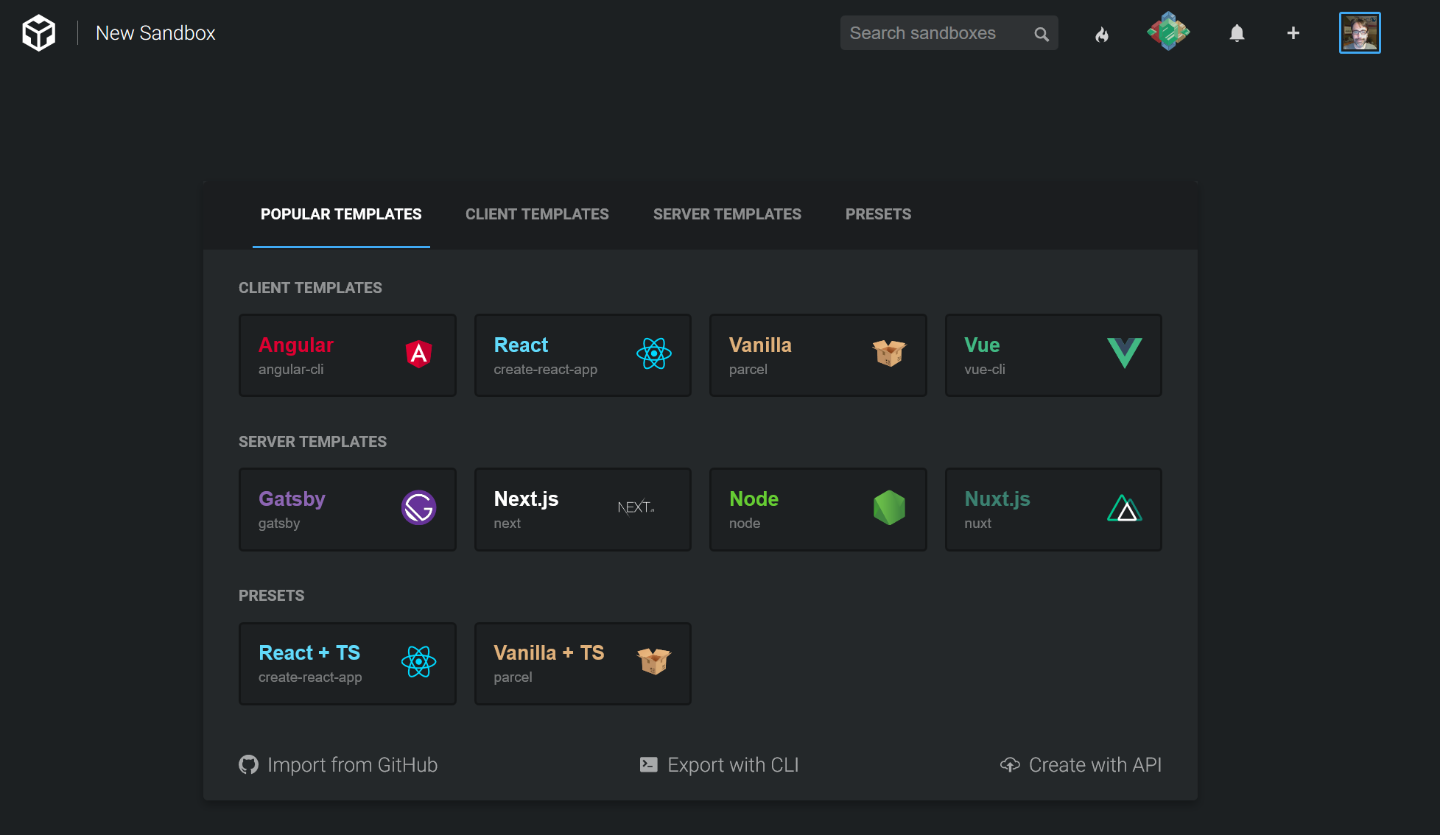
How?
Command Line tool
An online tool (CodeSandbox.io)

Slide 54
The CLI
Scaffolding and Building tool
Focused on SPAs (but also does prototyping well)
https://cli.vuejs.org
GUI Tool
Supports Single File Components

Slide 55
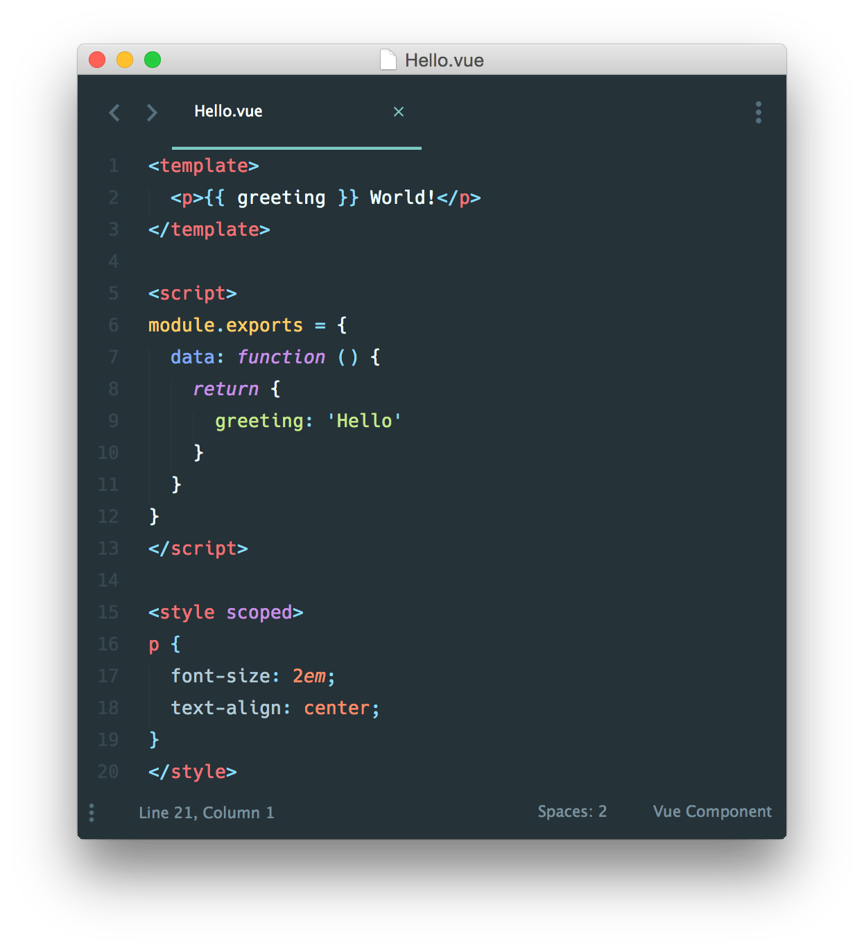
Single file Components

Slide 56
Walkthrough
FYI, install via: npm i -g @vue/cli
npm i -g @vue/cli-service-global
Then: vue create foo
Then: npm run serve
Then: npm run build
Then: Prototype example (note, no hot reload)
Then: UI example
Notes:
Demo after each point

Slide 57
Now What?
Organization becomes a bit simpler
Optimized output
Easier to Build Up

Slide 58
Routing
Not a part of Vue
Official library: vue-router (https://router.vuejs.org)
"If I'm at location /foo, I want to do Foo"
"If I'm at location /goo, I want to do Goo"
Installation via <script> tag or npm

Slide 59
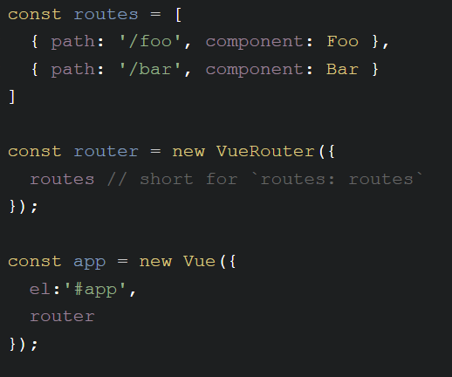
Example (From the Docs)

Slide 60
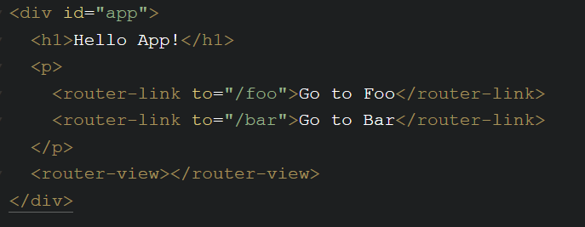
Example (Still from the docs)

Slide 61
Full Example: Home and About
First page – a home page
Second page – an about page
Use <router-link> and <router-view>
Use the CLI

Slide 62
Params and Dynamic RouteS
Routes can be dynamic
/user/:id
Dynamic portion available via $route.params.X
/user/:id/post/:post_id (stolen from docs)

Slide 63
More Routing Features
404/Catch All:
path: ‘*’
path: ‘feature-*’
Programmatic Navigation
router.push(‘something’)
router.replace(‘something’)
router.go(X)
HTML5 History mode
And more…

Slide 64
Full Example: MaIN/Detail
First page - list of data (based on an API, but can be anything)
Second page - detail

Slide 65
State Management
Solves a problem you may not have!
One component, one set of data = easy
Two components, two set of data = mostly easy
Many components, one set of data = um....

Slide 66
Vuex
(Another) library for Vue (deeply integrated)
https://vuex.vuejs.org/
"Store"
Components can read from the store
Components cannot change data in the store (directly)

Slide 67
Parts of Vuex
State
Mutations
Getters
Actions
Modules
Notes:
getters = computed for stores

Slide 68
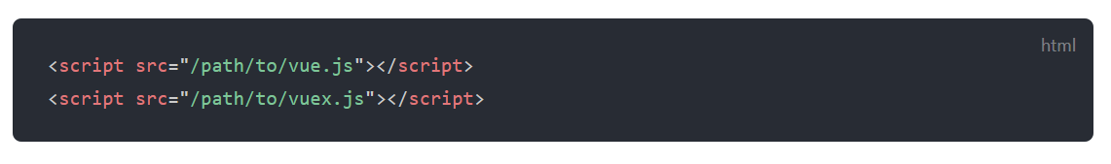
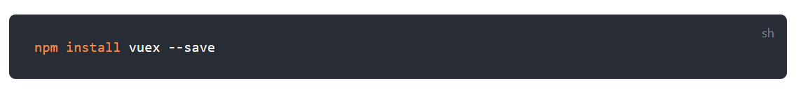
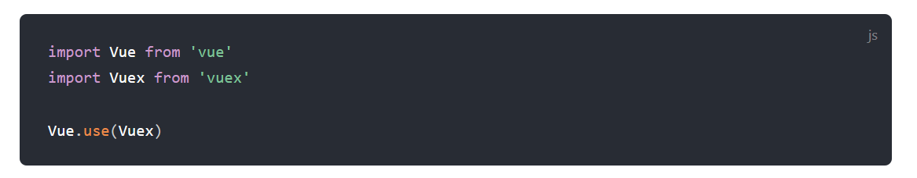
Including Vuex
Examples taken from docs....
Or...
Notes:
Similiar to router

Slide 69
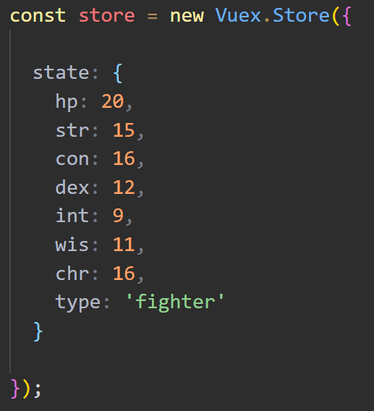
Creating a Vuex Store

Slide 70
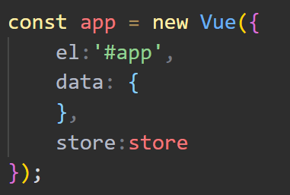
Adding the Store

Slide 71
Mutations
Change state
Called externally via: store.commit('name of mutation');
Or: store.commit('name of mutation', someAdditionalValue);

Slide 72
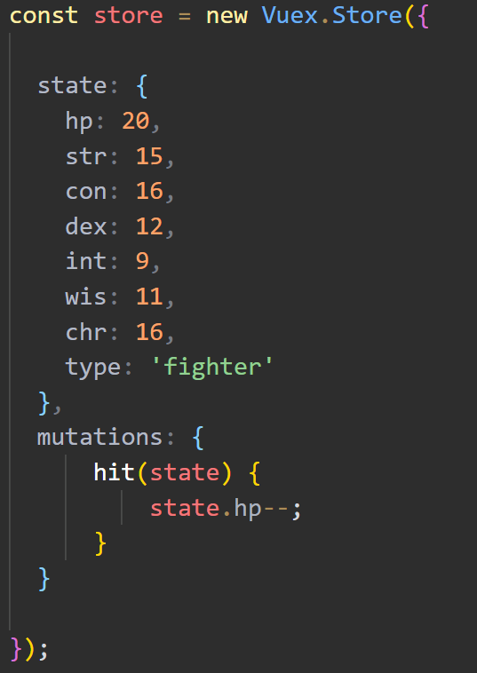
Example Mutation
To call: store.commit('hit');

Slide 73
Actions
Async
Chain to mutations
Called externally via store.dispatch('name of action', optional additional data);
If the distinction seems a bit weird... yes.

Slide 74
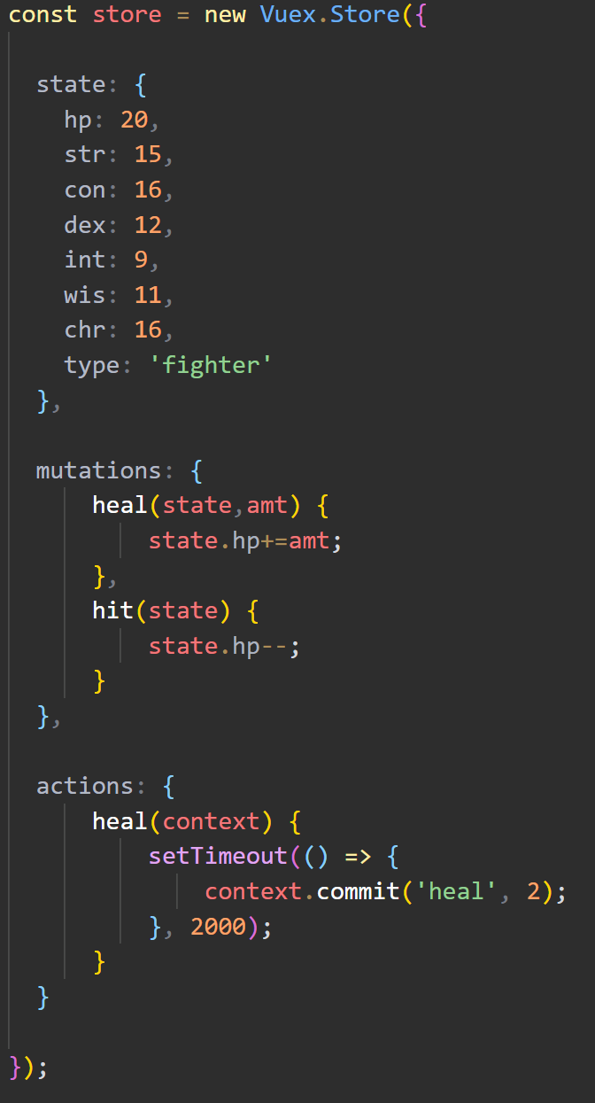
Example Action

Slide 75
Getters
Pretty much just computed for Vuex
Values are cached based on dependencies
Accessed externally via store.getters.nameOfGetter
Can return a function so you can do: store.getters.nameOfGetter(arg).

Slide 76
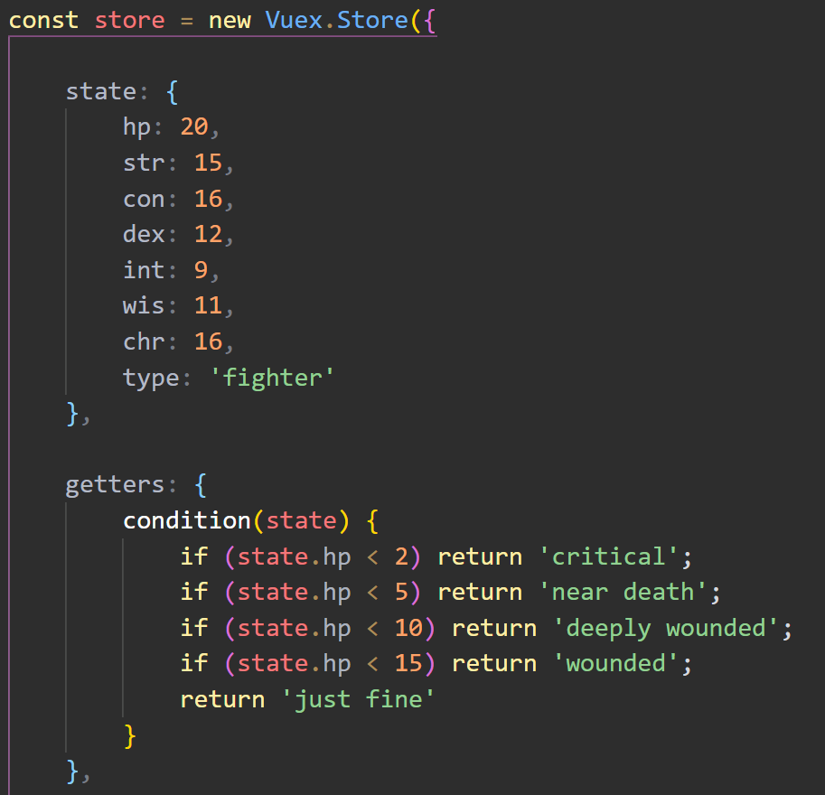
Example Getter

Slide 77
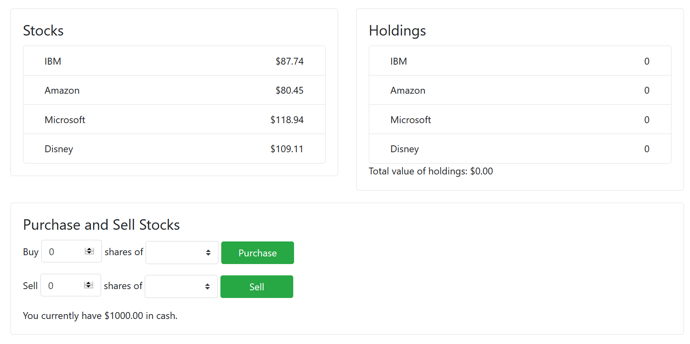
ONE MORE Vuex DEMO

Slide 78
3.0 - What's next?

Slide 79
Vue 3.0
Faster, smaller
Virtual DOM rewrite, native Proxy, 100% faster component instance initialization
20kb to roughly half (gzipped)
Multiple v-model support
<MyThing v-model:rank="userRank" v-model:title="userTitle" />
Suspense
Fallback support (ie, show this while loading)
Portals
Render content elsewhere, uses a <Teleport> tag

Slide 80
Vue 3.0
TypeScript Support
Vue itself - all in TS
No need for "wrapper" divs in template blocks (aka "Fragments")

Slide 81
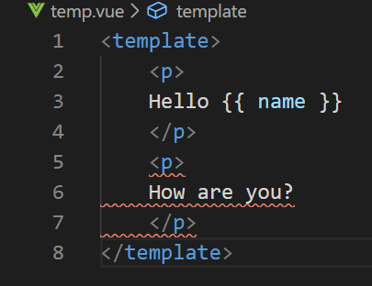
Vue 3.0

Slide 82
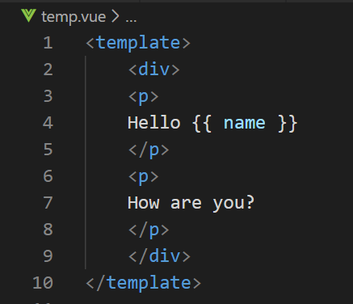
Vue 3.0

Slide 83
Vue 3.0

Slide 84
Vue 3.0
TypeScript Support
Vue itself - all in TS
No need for "wrapper" divs in template blocks (aka "Fragments")
Mounting changes to global libraries (add stuff to your Vue app, not global Vue object)
Composition API
OPTIONAL new way of writing components
Better for larger, complex architectures
Official repo: https://github.com/vuejs/vue-next

Slide 85

VUE 3 - RIP
Filters (deprecated)
render function (changed)
Event Bus (deprecated)
Photo by Charles Deluvio on Unsplash

Slide 86
Filters

Slide 87
Vue 3.0 - Learn MORE
Dan Vega on Vue 3 - https://www.youtube.com/watch?v=HmdKqXP8JR8
Upgrade guide - https://dev.to/blacksonic/the-vue-3-upgrade-guide-4dc4
Roundup - https://madewithvuejs.com/blog/vue-3-roundup

Slide 88

But wait – there’s more!

Slide 89
Even MOAR!!!
Devtools Extension (Chrome, Firefox, Electron, Apple Keynote Browser)
https://github.com/vuejs/vue-devtools
Sarah Drasner on CSS-Tricks: https://css-tricks.com/intro-to-vue-1-rendering-directives-events/
Vue docs has a cool cookbook: https://vuejs.org/v2/cookbook/
Newsletters:
https://news.vuejs.org
https://vuejsdevelopers.com/newsletter/
My Stuff: https://www.raymondcamden.com/tags/vuejs
Notes:
Show example of the devtools extension

Slide 90
Stuff I didn't cover
Unit Testing (https://vuejs.org/v2/guide/unit-testing.html)
Transitions (https://vuejs.org/v2/guide/transitions.html)
Custom Directives (https://vuejs.org/v2/guide/custom-directive.html)
More....

Slide 91

Any questions?

